Slide 1
International Debt Statistics
Low Level Design Document

Slide 2
PROJECT DETAILS
Project Title | Analyze International Debt Statistics
Technologies | Business Intelligence
Domain | Finance
Project Difficulties level | Intermediate
Tools used | Jupyter Notebook, tableau

Slide 3
1) Architecture
Objective:
The goal of this project is to analyze international debt data collected by The World Bank.
Benefits:
Gives better insight of international debt.
Helps in easy flow for managing resources.
Data visualizations will enhance the understanding of the debt data.
The data analysis will reveal some common and unique patterns in the dataset related to international debt.

Slide 4
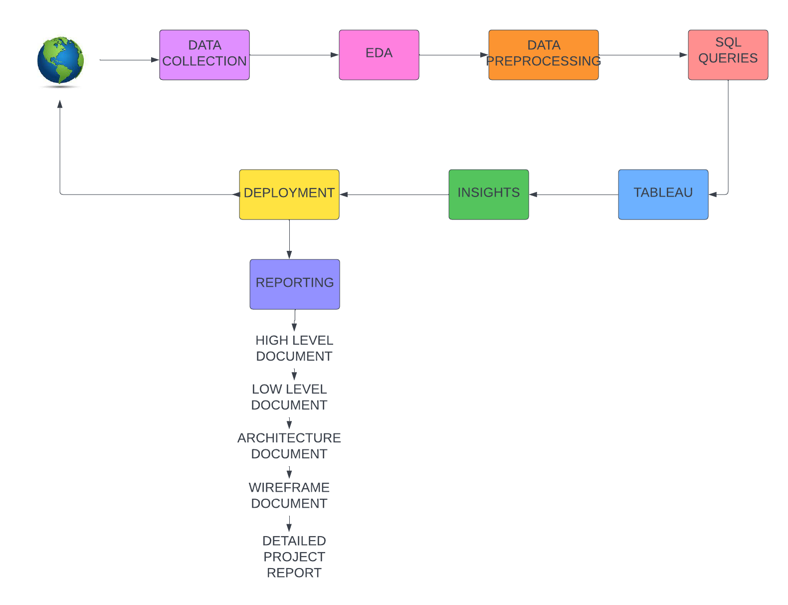

Slide 5
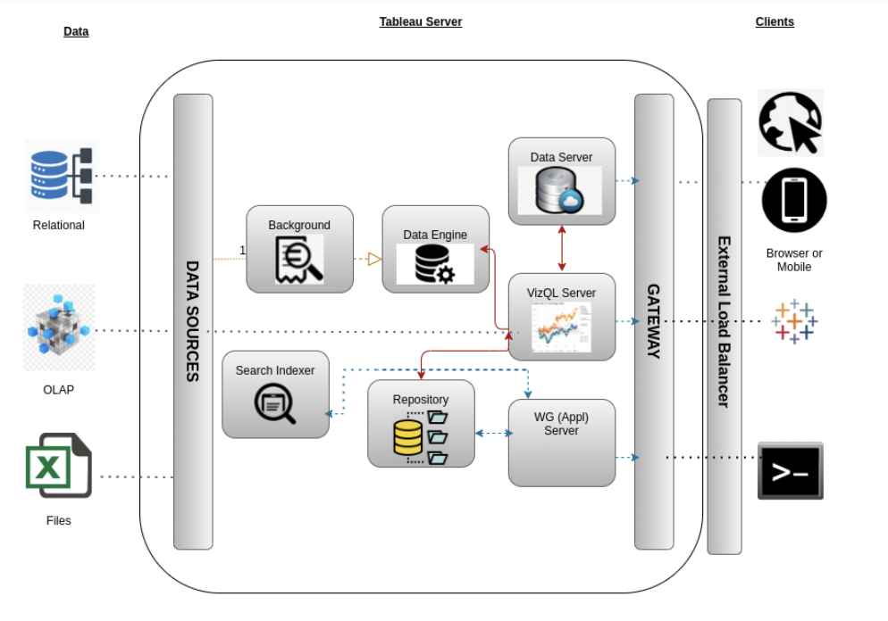
Tableau Server Architecture
Tableau has a highly scalable, n-tier client-server architecture that serves mobile clients, web clients and desktop-installed software. Tableau Server architecture supports fast and flexible deployments.

Slide 6
1) Gateway/Load Balancer
It acts as an Entry gate to the Tableua Server and also balances the load to the Server if multiple Processes are configured.
2) Application Server
Application Server processes (wgserver.exe) handle browsing and permissions for the Tableau Server web and mobile interfaces. When a user opens a view in a client device, that user starts a session on Tableau Server. This means that an Application Server thread starts and checks the permissions for that user and that view.
3) Repository
Tableau Server Repository is a PostgreSQL database that stores server data. This data includes information about Tableau Server users, groups and group assignments, permissions, projects, data sources, and extract metadata and refresh information.

Slide 7
4) VIZQL Server
Once a view is opened, the client sends a request to the VizQL process (vizqlserver.exe). The VizQL process then sends queries directly to the data source, returning a result set that is rendered as images and presented to the user. Each VizQL Server has its own cache that can be shared across multiple users.
5) Data Engine
It Stores data extracts and answers queries.
6) Backgrounder
The backgrounder Executes server tasks which includes refreshes scheduled extracts, tasks initiated from tabcmd and manages other background tasks.
7) Data Server
Data Server Manages connections to Tableau Server data sources. It also maintains metadata from Tableau Desktop, such as calculations, definitions, and groups.

Slide 8
2) Architecture Description
3.1 Data Description
The Dataset contains the country name, debt amount from 1970 to 2028 of all countries. The dataset contains information about the amount of debt (in USD) owed by developing countries across several categories. It contains both national and regional debt statistics for several countries across the globe as recorded from 1970 to 2015.
Country Name
Country Code
Counterpart-Area Name
Counterpart-Area Code
Series Name
Series Code
1970 to 2028

Slide 9
3.2 Data Transformation
In the Transformation Process, we will convert our original datasets with other necessary
attributes format. And will merge it with the Scrapped dataset.
3.3 Make the SQL connection and set up the data source
Step-1 : Configuring Tableau
Launch Tableau on your workstation and select SQL Server from the connect column on the left. This will open a dialogue box where you need to provide the connection details for SQL Server. To connect with tableau, you will need to provide information about the server which hosts your database. If you want to connect to a contained database, you can also specify the name of the database.
To connect with a port other than the default port, you need to specify the port and server as follows:
<server_name><port_number>
Example query: my_server 8051
There are two ways in which you can sign-in to the server, either by using Windows authentication or by using the username and password. Using the username and password becomes a must if you’re working with a password-protected server in a non-Kerberos environment.

Slide 10
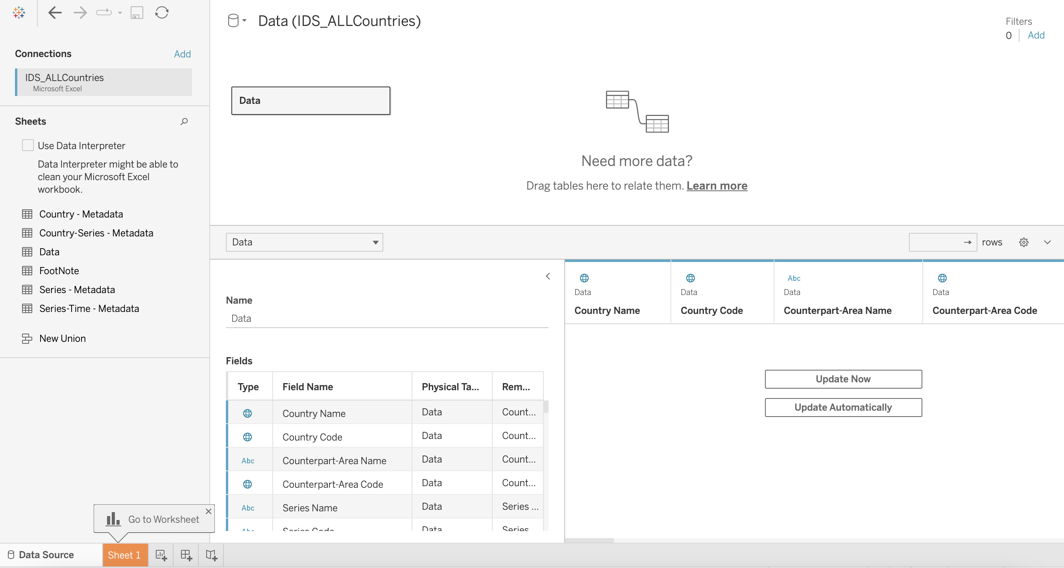
Click on Sign in to establish a connection. This will enable a connection without SSL. To establish an SSL enabled connection, click the Require SSL checkbox before you sign in.
SQL Server provides an option to let the user queries access the modified rows even before they have been committed. This option is called Read Uncommitted data. It saves time by preventing complex queries such as extract refreshes from locking the database and causing a delay. If this option is unchecked, Tableau makes use of default isolation levels.
Step-2 : Configuring Data Source
The data source page loads up after configuring the Tableau connector and successfully signing in. This is how the page looks like

Slide 11
Select the data source name option and give a unique name to the database you are using. It’s considered a good practice to have a unique name as it makes it much easier for users to identify the database from which data is being fetched.
To select the desired schema, you can use the schema drop-down list from the column on the left. You can also perform a text-based search to find the desired option. Now similarly find and select the desired table and drag it onto the canvas.
3.4 Export Data From Data-Base
Data Export from Database - The data in a stored database is exported as a CSV file to be used for Data Pre-processing.
3.5 Deployment Once you’ve completed your dashboard, follow these steps:- Server, Tableau Public, Save to Tableau Public As. You may be prompted to log into your Tableau Public profile first if this is your first time publishing.

Slide 12
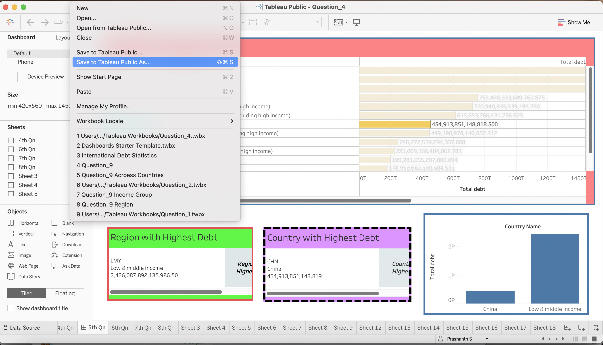
Tableau Public cannot host live connections, so you’ll need to convert your connection to an extract (like a frozen screenshot of your data).

Slide 13
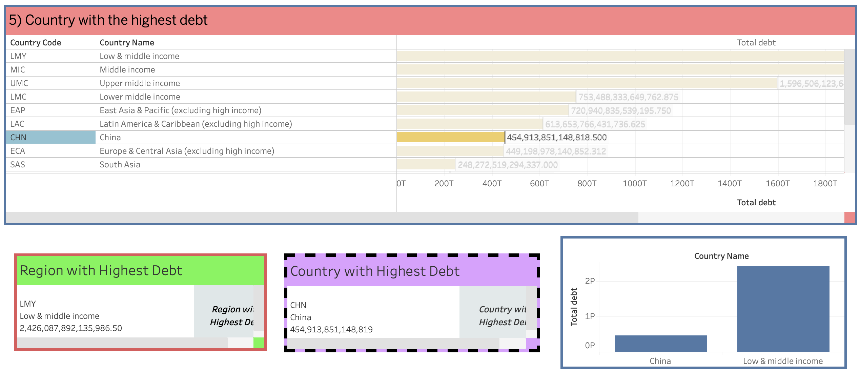
Here in the below screenshot, we can see that out workbook has been published to tableau public.

Slide 14
3) Unit Test Cases
Test Case Description | Expected Results
Total Debt Indicator | It is an detailed indicator of the debt ranges
Series Code Slicer | When clicked on the slicer, a dropdown occur with various series code.
Region Country Slicer | When clicked on the slicer, a dropdown occur with the availbale regions across the entire world.
Relationship between Series Code and Regions | Particular selection of Series Code and Regions shows the debt level from low to high (green to red)
Total amount of Debt owned by the countries | Will go through the world map completely, on selecting the regions their debt amount will be highlighted

Slide 15
THANK YOU.

